Slide 1
Fly Emirates Data Analysis
Aditya Verma
Business/Data Analyst Innovexis

Slide 2
Introduction
1. Company / Industry Overview: The U.S. aviation industry is one of the largest transportation networks in the world, handling millions of passengers and flights each year. To maintain operational efficiency and improve passenger experience, airlines and airport authorities rely heavily on data-driven analysis to monitor flight performance, delays, and cancellations. This project focuses on analyzing aviation operational data to identify patterns in flight disruptions and evaluate airline and airport performance.
2. Dataset Overview: The analysis is based on a large historical dataset containing over 15 million flight records from U.S. airline operations. The dataset includes detailed information about flight schedules, airlines, airports, delays, cancellations, and diversion events, enabling a comprehensive evaluation of operational performance across the aviation network.
3. Problem Statement: Flight delays and cancellations remain a major challenge in the aviation industry, affecting passengers, airlines, and airport operations. This project aims to identify the key drivers of delays and cancellations, analyze operational performance across airlines and airports, and understand how temporal factors such as month, day of week, and routes influence flight disruptions.
4. Business Objectives: The primary objective of this project is to analyze flight performance and disruption patterns using data analytics. The study benchmarks airline performance, evaluates airport operational efficiency, and identifies the major factors contributing to delays and cancellations. These insights can help airlines and airport authorities improve scheduling, reduce operational disruptions, and enhance overall passenger experience.
5. Expected Outcome: By analyzing large-scale aviation data, the project provides data-driven insights into operational inefficiencies, delay propagation, and disruption patterns, helping stakeholders make informed decisions to improve airline reliability and airport performance.

Slide 3
Agenda of the Meeting
1. Dataset and Methodology Overview
Overview of the dataset structure, including flight, airline, and airport data, along with the data preparation process using SQL, data cleaning steps, and integration of multiple datasets to create a unified analytical dataset.
2. Key Performance Indicators (KPIs)
Discussion of the main metrics used to evaluate operational performance, including total flights, average arrival and departure delays, cancellation rates, diversion counts, and delay distribution by type.
3. Key Insights and Findings
Presentation of major insights identified through the analysis, including primary causes of delays, cancellation patterns, airline performance differences, and congestion trends across major hub airports.
4. Recommendations
Discussion of data-driven recommendations aimed at improving operational efficiency, reducing delays, and enhancing airline and airport performance.
5. Conclusion and Discussion
Summary of the key findings from the project and an open discussion for questions, feedback, and potential next steps for operational improvements.

Slide 4
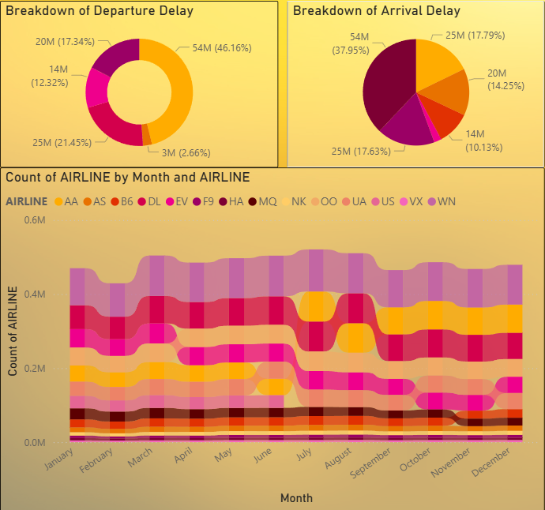
Overview
Overview of Flight Operations
The dashboard provides a high-level overview of airline operations in the United States. The dataset contains approximately 6 million flights, out of which around 90,000 flights were cancelled, representing about 1.5% of total flights. In total, flights covered nearly 5 billion miles of distance and accumulated approximately 649 million minutes of air time, highlighting the large operational scale of the aviation network.
Departure Delay Analysis
Departure delays are mainly driven by airline operational issues, which account for about 46% of total departure delays (54 million minutes). Other contributing factors include late aircraft delays (21%), weather delays (17%), air traffic system delays (12%), and security delays (around 3%), indicating that internal airline operations are the primary cause of delays

Slide 5
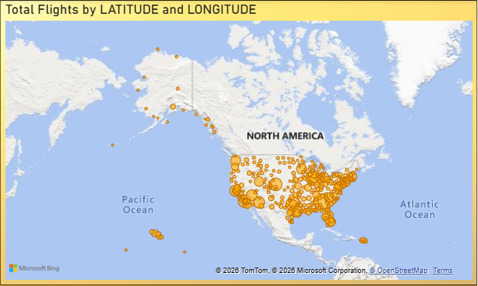
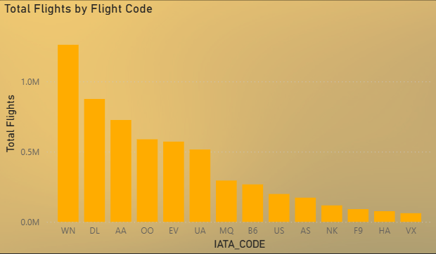
Overview
Arrival Delay Analysis
Arrival delays are largely influenced by late aircraft delays, contributing nearly 38% of total arrival delays. Airline delays and NAS delays each contribute around 17–18%, followed by weather-related delays (14%) and security delays (10%), showing how delays from earlier flights propagate through the schedule.
Airport and Traffic Insights
The dashboard highlights major aviation hubs such as ATL, ORD, DFW, DEN, and LAX, which handle the highest flight volumes. The geographic map further shows that flight activity is heavily concentrated across major U.S. travel corridors, reflecting the hub-and-spoke structure of airline networks.

Slide 6
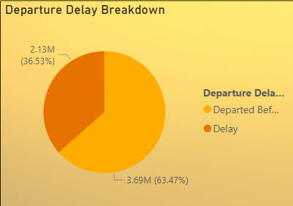
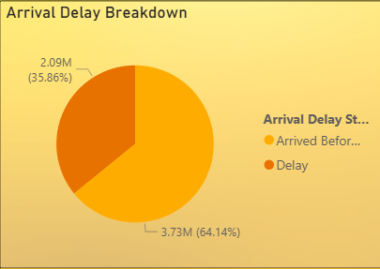
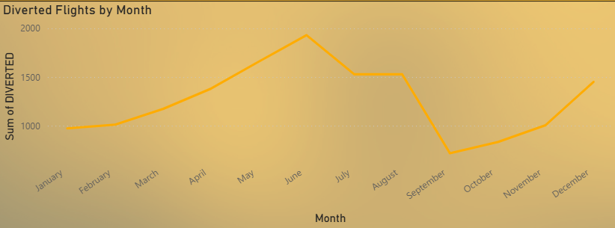
Delay Analysis
Delay Performance Overview
This page focuses on analyzing flight delay performance across the dataset. The average arrival delay is approximately 4.41 minutes, while the average departure delay is higher at around 9.37 minutes, indicating that most delays occur before flights depart. Additionally, the dataset records about 15,000 diverted flights, showing the operational impact of disruptions.
Delay Comparison Insight
The arrival-to-departure delay ratio is approximately 0.47, which suggests that airlines are able to recover nearly half of the departure delay during flight operations, likely through faster cruising speeds or schedule buffers.

Slide 7
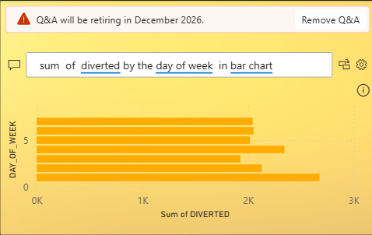
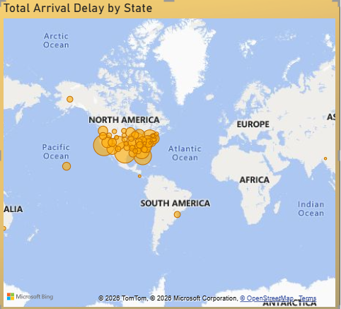
Delay Analysis
Delay Distribution
The delay breakdown charts show that around 64% of flights depart and arrive on time or earlier, while roughly 36% experience delays, highlighting that although delays exist, the majority of flights still operate within schedule.
Diversion and Geographic Insights
The dashboard also shows diverted flight trends across months, where diversions peak around mid-year months and decrease towards early fall. Additionally, the geographic map highlights concentrations of arrival delays across major U.S. aviation hubs, indicating that high-traffic airports are more prone to delays due to congestion and operational complexity.

Slide 8
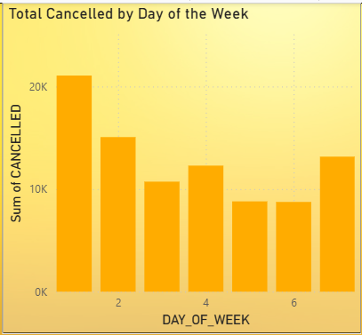
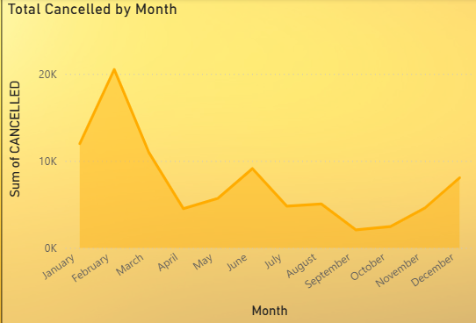
Cancellation Analysis
Overall Cancellation Overview
This page focuses on analyzing flight cancellations across the dataset. Out of approximately 6 million flights analyzed, around 90,000 flights were cancelled, representing roughly 1.5% of the total flight operations. Although this percentage appears relatively small, cancellations can significantly impact airline schedules, passenger experience, and airport operations.
Cancellation Reasons Analysis
The dashboard highlights the primary causes of cancellations across the aviation network. Carrier-related operational issues account for the largest share of cancellations, with approximately 49,000 cancelled flights, indicating that airline operational challenges such as crew availability, aircraft maintenance, or scheduling conflicts are the most significant contributors. Weather-related disruptions account for around 25,000 cancellations, demonstrating the impact of severe weather conditions on flight schedules. Additionally, air traffic system (NAS) issues contribute approximately 16,000 cancellations, reflecting delays caused by congestion or operational constraints in the national airspace system. Security-related cancellations are minimal compared to the other causes.

Slide 9
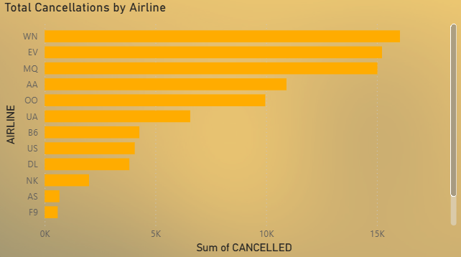
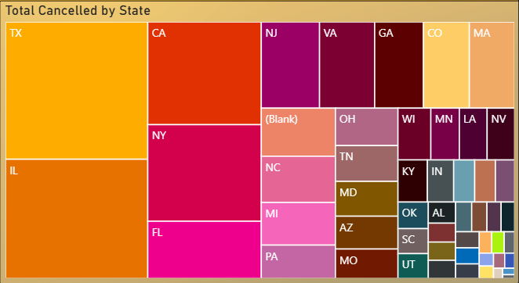
Cancellation Analysis
Cancellation Trends by Time
The dashboard also analyzes how cancellations vary across time. When observing cancellations by day of the week, the data indicates that some days experience higher cancellation volumes than others, which may be influenced by operational scheduling patterns or travel demand fluctuations. The monthly cancellation trend shows a significant peak during February, with cancellations exceeding 20,000 flights, which is likely associated with severe winter weather conditions that disrupt airline operations.
Airline-Level Cancellation Patterns
From an airline perspective, certain carriers experience higher cancellation counts compared to others. Airlines such as WN (Southwest Airlines), EV (ExpressJet Airlines), and MQ (Envoy Air) report the highest number of cancellations. This pattern may be influenced by the size of their operations, as airlines with higher flight volumes naturally experience a greater number of disruptions.
Geographic Distribution of Cancellations
The geographic visualization highlights how cancellations are distributed across U.S. states. States such as Texas, Illinois, and California exhibit the highest cancellation counts. These states host several major aviation hubs, including Dallas/Fort Worth International Airport, Chicago O’Hare International Airport, and Los Angeles International Airport, which handle a large share of national flight traffic. As a result, higher traffic volumes in these regions increase the likelihood of cancellations during operational disruptions.

Slide 10
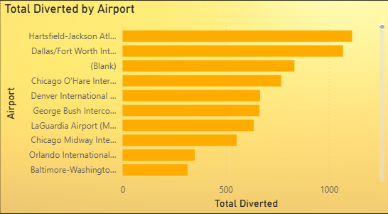
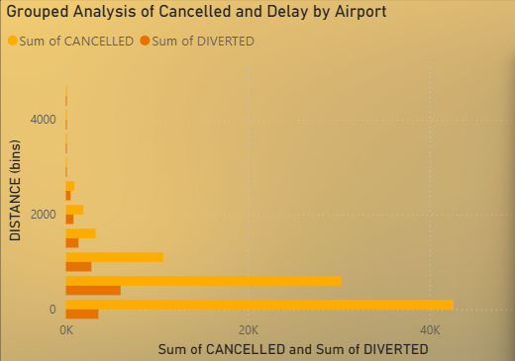
Cancellation and Delay Analysis
Airport Disruption Overview
This page focuses on analyzing how flight disruptions vary across different airports. The dataset shows approximately 90,000 cancelled flights, 15,000 diverted flights, and nearly 81,000 minutes of security-related delays. These metrics highlight the operational challenges faced by major airports and the impact of disruptions on flight schedules.
Diversions by Airport
The analysis of diverted flights by airport shows that major hub airports experience the highest number of diversions. Airports such as Hartsfield–Jackson Atlanta International Airport (ATL) and Dallas/Fort Worth International Airport (DFW) record the highest diversion counts, exceeding 1,000 diverted flights. Other busy airports like Chicago O’Hare (ORD), Denver International Airport (DEN), and George Bush Intercontinental Airport (IAH) also show notable diversion volumes. This trend indicates that high-traffic airports are more susceptible to diversions due to congestion, weather disruptions, and operational complexity.
Distance-Based Disruption Analysis
The grouped analysis chart compares cancellations and diversions across different flight distance ranges. The visualization suggests that short to medium-distance flights experience higher disruption counts, while long-distance flights show relatively fewer cancellations and diversions. This pattern may be influenced by the higher frequency of short-haul flights within airline schedules.

Slide 11
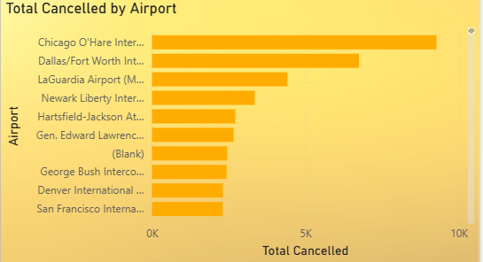
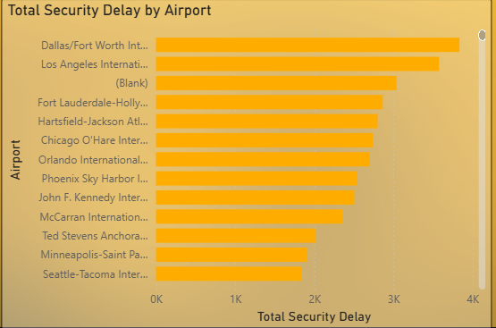
Cancellation and Delay Analysis
Flight Cancellations by Airport
The dashboard also highlights airport-level cancellation patterns. Chicago O’Hare International Airport (ORD) reports the highest number of cancellations, reaching close to 10,000 cancelled flights. Other airports such as Dallas/Fort Worth International Airport (DFW), LaGuardia Airport (LGA), Newark Liberty International Airport (EWR), and Hartsfield–Jackson Atlanta International Airport (ATL) also show significant cancellation volumes. These airports are among the busiest aviation hubs, which increases the likelihood of disruptions during operational or weather-related challenges.
Security Delays by Airport
Security-related delays are another factor affecting airport operations. The dashboard indicates that Dallas/Fort Worth International Airport and Los Angeles International Airport (LAX) experience the highest security delay times, reaching nearly 4,000 minutes of total security delays. Other airports including Fort Lauderdale, Chicago O’Hare, Orlando International Airport, and Phoenix Sky Harbor also report notable security delay times, reflecting the operational impact of security screening processes.

Slide 12
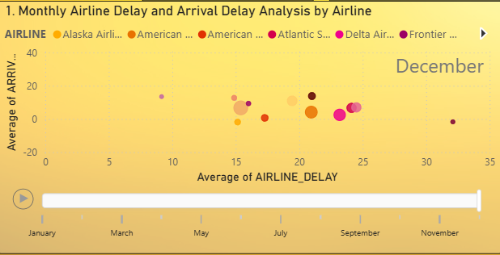
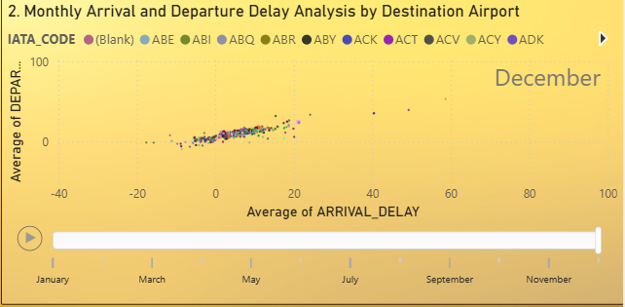
Co-Realtions
Correlation Overview
This page focuses on analyzing the relationship between different types of delays across airlines and airports. The correlation values displayed at the top show how strongly different delay variables move together. The analysis reveals strong positive relationships between several delay metrics, with correlation values ranging from 0.79 to 0.89, indicating that delays in one stage of flight operations often propagate to later stages.
Airline Delay and Arrival Delay Relationship
The first visualization analyzes the relationship between average airline delay and average arrival delay across different airlines over time. The scatter plot shows a positive correlation of approximately 0.79, suggesting that when airline-related operational delays increase, arrival delays tend to increase as well. This indicates that airline operational efficiency plays a significant role in determining arrival performance.

Slide 13
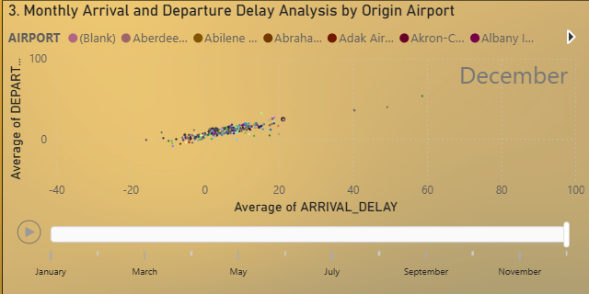
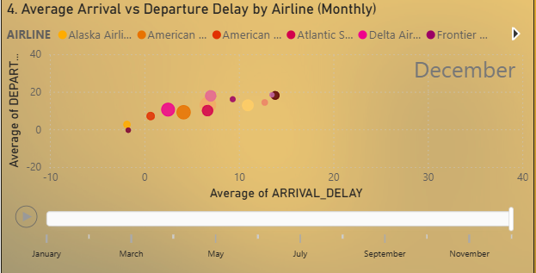
Co-Realtions
Destination Airport Delay Relationship
The second analysis examines the relationship between arrival delays and departure delays across destination airports, showing a correlation value of approximately 0.82. This indicates that airports experiencing higher arrival delays are also likely to experience higher departure delays, reflecting the cascading effect of delays within busy airport operations.
Origin Airport Delay Relationship
Similarly, the analysis of origin airports reveals a strong positive correlation between arrival and departure delays across different airports. The scatter plot shows a correlation value close to 0.89, which suggests that airports with higher arrival delays tend to also experience higher departure delays due to operational congestion and turnaround time constraints.
Delay Comparison by Airline
The final visualization compares average arrival delay and departure delay across airlines on a monthly basis. The plot shows that most airlines cluster within a moderate delay range, indicating relatively similar delay patterns across carriers, though some airlines experience higher operational delays than others during specific months.

Slide 14
Key Takeaways
The analysis of approximately 6 million flight records reveals that the U.S. aviation network operates at a large scale but still faces operational disruptions. Around 90,000 flights were cancelled and approximately 15,000 flights were diverted, indicating the impact of operational and environmental challenges. On average, departure delays (9.37 minutes) are higher than arrival delays (4.41 minutes), suggesting that most delays originate before takeoff, although airlines are able to recover some delay during flight operations.
The majority of cancellations are driven by carrier operational issues and weather conditions, while disruptions are more concentrated around major hub airports such as ATL, ORD, and DFW. Overall, the findings indicate that airline operations, airport congestion, and external factors like weather are the key drivers of flight disruptions across the aviation network.
The analysis shows that departure delays average 9.37 minutes, which is higher than the average arrival delay of 4.41 minutes, indicating that most delays occur before flights depart. Despite this, airlines manage to recover some of the delay during flight, as reflected by the arrival-to-departure delay ratio of 0.47. Additionally, about 64% of flights operate on time, while 36% experience delays, and the dataset records approximately 15,000 diverted flights, with delays concentrated around major U.S. aviation hubs.
The analysis suggests that airline operational issues and weather conditions are the primary drivers of flight cancellations, while cancellations tend to concentrate around high-traffic airlines, major aviation hubs, and winter travel months.
The analysis shows that major hub airports such as ATL, ORD, and DFW experience the highest levels of operational disruptions, including cancellations, diversions, and security delays. This is largely driven by high flight traffic, airport congestion, and operational complexity within major aviation hubs.
The analysis shows that major hub airports such as ATL, ORD, and DFW experience the highest levels of operational disruptions, including cancellations, diversions, and security delays. This is largely driven by high flight traffic, airport congestion, and operational complexity within major aviation hubs.

Slide 15
Conclusion
The analysis of approximately 6 million flight records provides insights into operational efficiency, delays, and disruptions within the U.S. aviation network. The findings show that while the majority of flights operate as scheduled, a notable portion of operations is affected by delays, cancellations, and diversions. On average, departure delays (9.37 minutes) are significantly higher than arrival delays (4.41 minutes), indicating that most disruptions originate during the pre-departure phase, such as aircraft preparation, crew availability, or ground operations. However, airlines are able to partially recover these delays during flight, reducing the impact on arrival times.
The analysis also highlights that carrier-related operational issues and weather conditions are the primary drivers of cancellations, contributing to approximately 90,000 cancelled flights, while around 15,000 flights were diverted due to operational or environmental factors. Disruptions are more prominent at major aviation hubs such as Atlanta (ATL), Chicago O’Hare (ORD), and Dallas/Fort Worth (DFW), where high flight traffic increases the likelihood of congestion and delay propagation.
Correlation analysis further demonstrates that delays are highly interconnected across airline operations and airport activities, meaning that delays in one stage of the flight process often cascade into later stages. Overall, the findings suggest that improving ground operations, airline scheduling efficiency, and delay management at major hub airports could significantly reduce flight disruptions and enhance overall airline operational performance.

Slide 16
Thank You
Aditya Verma
Data/Business Analyst at Innovexis

